Slide 1
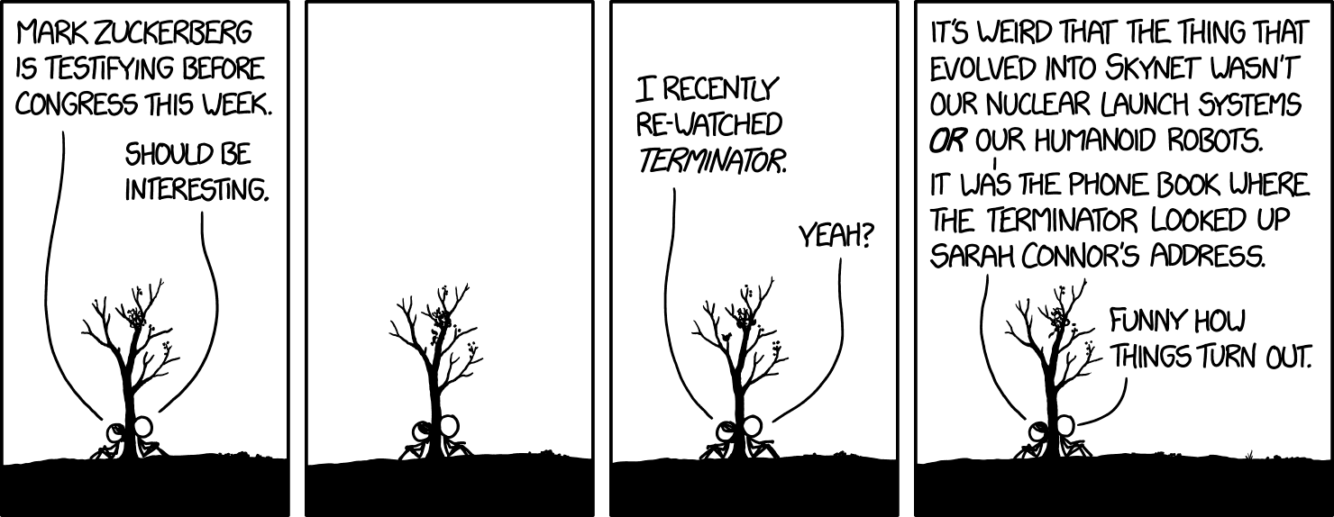
Alt Text: James Cameron's Terminator 3 was the REALLY prophetic one. That's why Skynet sent a robot back to the 1990s to prevent him from ever making it, ultimately handing the franchise over to other directors." alt="Congressional Testimony

Slide 2
Game AI

Slide 3
Housekeeping
Quiz on distributed computing next week instead
Quiz on this at a TBD time (this gives us the minimum number of mandated tests so it’ll be the last)
Is something wrong? People are struggling but aren’t asking questions
I try to answer all of them well, but please ask them more than 24 hours before the thing is due and to send emails to Matt along with me
Videos are substantially delayed again (mostly my fault this time)
Server shuts down after class?
GANs are in this lecture because I screwed up
Remaining classes

Slide 4
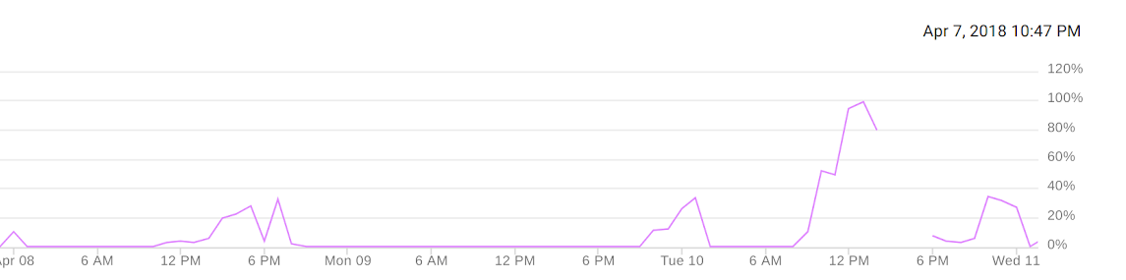
Regarding the server
Google kills instance, sends angry email
First time someone crashed the server, added more CPU ram
Times the server was overloaded and I got emails
Malware starts
Someone crashed the server again
CPU
Note GPU utilization will hit 100% well before CPU will for any work for class, but CPU usage is roughly proportional to GPU usage
Original setup barely had enough CPU ram; still doesn’t account for crash

Slide 5
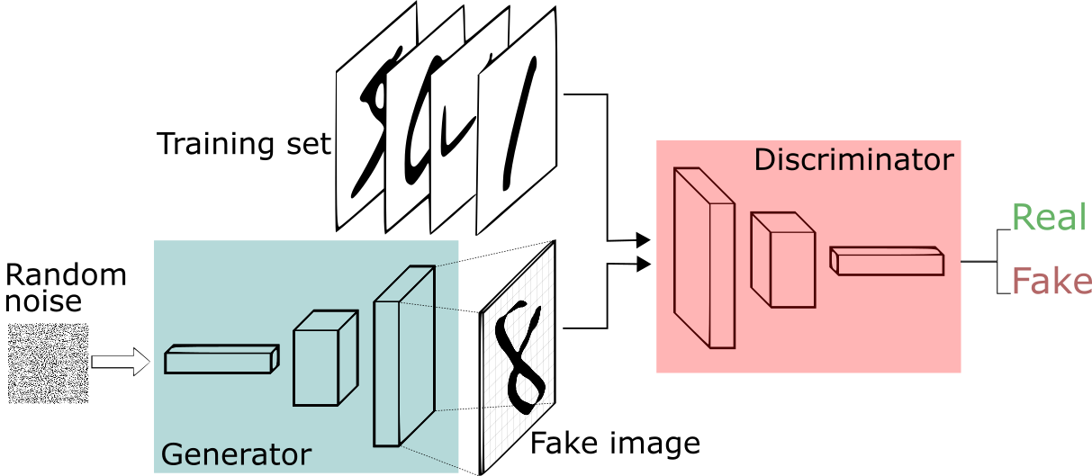
Generative Adversarial Networks (these are really cool to me, I apologize in advance)

Slide 6
https://ai.intel.com/demystifying-deep-reinforcement-learning/

Slide 7
https://github.com/jayleicn/animeGAN

Slide 8
https://www.youtube.com/watch?v=ITATOXVvWEM

Slide 9
https://github.com/luanfujun/deep-photo-styletransfer

Slide 10
Can you train an AI to play StarCraft 2 based on example data?

Slide 11
https://www.youtube.com/watch?v=79pmNdyxEGo&t=170s
When you stop understanding what he’s saying please raise your hand

Slide 12
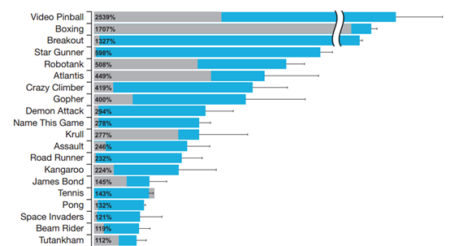
Generality of reward functions is hard and unsolved

Slide 13
Final Project
200 project points
Homework/projects and final projects part of syllabus merged to make effort fair; there were less homeworks than we expected
It will be very difficult for this to hurt your grade
Groups of ~3-5, talk to me
Should involve per person work equivalent to the set of 4 tensorflow problems
Due via informal presentation during or before official finals time
Topic must be submitted via email for approval, by me, any time before class on April 25th (our last normal class)
You must include at least some sort of rationalization of how this applies to STEM research in it (not our choice)
3-5 people over a month should be able to produce something pretty substantial
Using neural nets is optional but recommended
To get full credit
Submit a topic that I approve of, on time, in a form that is of reasonable quality
Finish a reasonably large amount of work (this doesn’t necessarily mean your thing has to 100% work yet)
Present it in a coherent way
Don’t do anything stupid we’ve covered in class in setting up your ML models (i.e. using an auto encoder when you shouldn’t, using an unrelated loss function, etc.)

Slide 14
Ideas For Final Project Topics
Game AIs (Open AI universe, SC2, etc)
Anything with GANs
I think procedural generation of video game worlds has a lot of untapped potential
Creating ultra optimized neural networks
Getting a TPU working (limit 2 people for that alone)
Running TensorFlow on OpenCL (limit 3 people for that alone)
Creating a neural net PaaS platform with a nice UI
Function replication or identifying eigenvectors for chaotic systems
Work you’re already doing for labs/companies may be able to count, but talk to me first
Financial analysis (especially loan risk assessment)
Classification of astronomical images

Slide 15
What now
I wanted to go through how to use Open AI Gym in Detail
It was much more involved than I realized
People can
Leave
Watch me try to talk through a (really good this time) piece of sample code for Gym
Using gym won’t be graded unless you want to use it in your final project
Work on things in the lab where Matt will be for questions

